Slide 1





FREEDOM Tech October 2025
SMART TECHNOLOGY
SMART PROCESSES
SMART PEOPLE

Slide 2

Cloudfm have been established since 2011 in the UK and we have built our reputation on our innovative facilities management and PropTech solutions with a committed focus on doing the right thing.
We create positive behavioural change in people's energy consumption and built environment management through our cutting-edge AI and engineering technologies to drive a meaningful and sustainable future.
Be first to the future ….
2

Slide 3
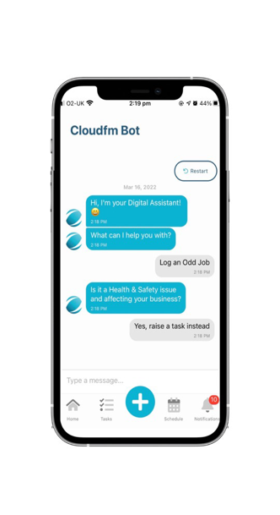

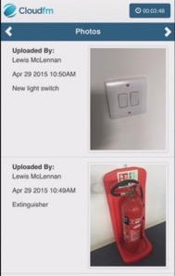


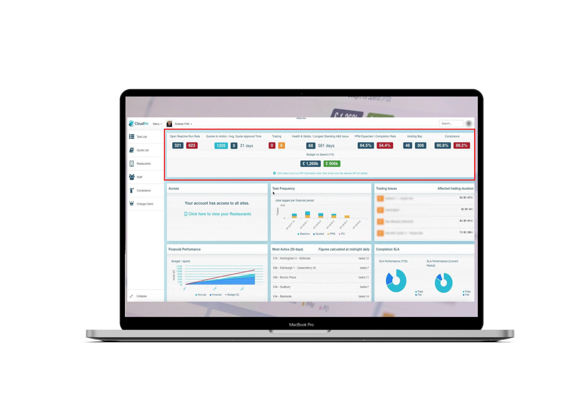



THE CLOUD PLATFORM
FREEDOM
WINNER OF THE QUEENS AWARD FOR ENTERPRISE 2019
Engineer
App
Client App
The Freedom platform is a workflow management system designed to work seamlessly in line with each client’s business
Once data is inputted, nothing can be edited, unlike the more common Computer Aided Facilities Management systems (CAFM)
Freedom is delivered through an online portal and a Customer app, with field engineers working through a specialist app, minimising administrative processes and ensuring everything is submitted directly to the system
The platform automates billing information for all works carried out and delivers transparency and control for associated costs
Client Portal
OUTCOMES
OUTCOMES
Our Freedom Platform will provide our clients with Transparency, Compliance & Quality and Cost Control across their estates.

Slide 4
Driving Performance through Technology and Process
Failure or Breakage
Manager
Raises Issue
Job Logged
Task Incomplete
Raise Recall
Repeat issue?
Sign Off Submitted
Quote
agreed?
Quote Submitted
Usual measurement points
CAFM & Helpdesk improvements
Cloudfm measures all points
Identify Warranty
Warranty?
Contractor Agrees Date
Details captured
Task Incomplete
Need
Assessed
Helpdesk Advises Site
Parts
Obtained
Parts only issue?
Quote required?
Engineer leaves site
Marked as Complete
Invoice
Paid
Initiate Task
Location Assessed
Helpdesk
Logs Details
Engineer advises ETA
Made Safe
Job Sheet Signed
Engineer leaves site
Helpdesk Advised
Accrued Cost available
Contractor instructed
Engineer advises ETA
Engineer attends site
Job done?
Manager Notified
Invoice checked
Match to accrual?
Contractor advises Engineer
Engineer confirms attending
Task Completion
Job Sheet Submitted
Invoice raised by Contractor
Invoice Submitted
Payment Claim
Invoice
Re-raised Contractor
Invoice Returned

Slide 5
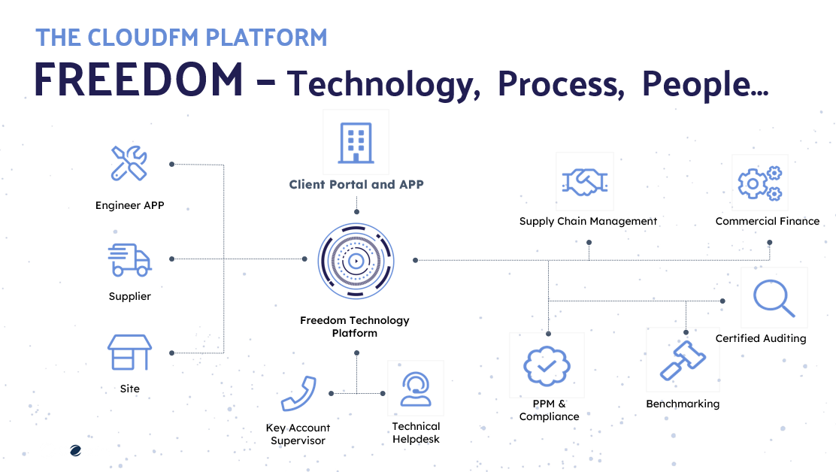

Slide 6
THANK YOU Contact us: cloudflex@cloudfmgroup.com

